Slide 1
CART Algorithm
Decision Tree Learning

Slide 2
CART Algorithm
It can handle both classification and regression tasks.
This algorithm uses a new metric named gini index to create decision points for classification tasks.

Slide 3
Gini Index
It stores sum of squared probabilities of each class.
Gini = 1 – Σ (Pi)² for i=1 to number of classes.

Slide 4
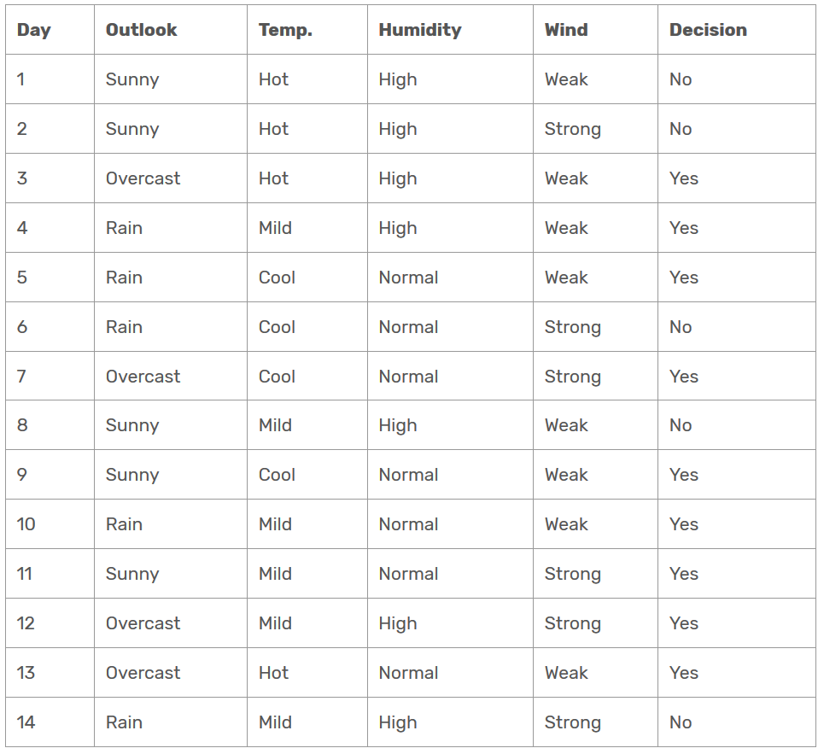
Dataset

Slide 5
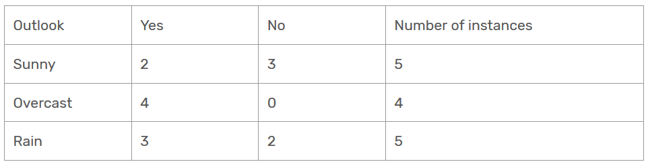
Outlook for Decision
Outlook is a nominal feature. It can be sunny, overcast or rain.
Gini(Outlook=Sunny) = 1 – (2/5)² – (3/5)² = 1 – 0.16 – 0.36 = 0.48
Gini(Outlook=Overcast) = 1 – (4/4)² – (0/4)² = 0
Gini(Outlook=Rain) = 1 – (3/5)² – (2/5)² = 1 – 0.36 – 0.16 = 0.48
Then, we will calculate weighted sum of gini indexes for outlook feature.
Gini(Outlook) = (5/14) x 0.48 + (4/14) x 0 + (5/14) x 0.48 = 0.171 + 0 + 0.171 = 0.342

Slide 6
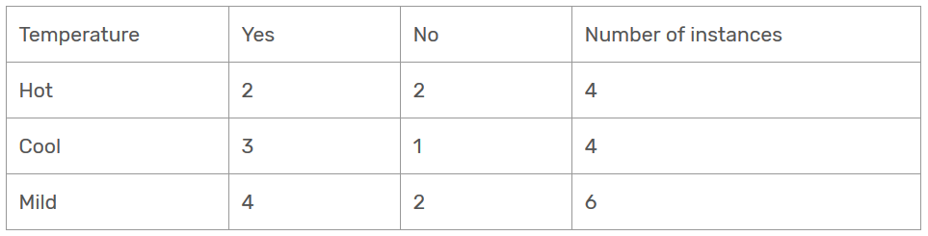
Temperature
Similarly, temperature is a nominal feature and it could have 3 different values: Cool, Hot and Mild.
Gini(Temp=Hot) = 1 – (2/4)² – (2/4)² = 0.5
Gini(Temp=Cool) = 1 – (3/4)² – (1/4)² = 1 – 0.5625 – 0.0625 = 0.375
Gini(Temp=Mild) = 1 – (4/6)² – (2/6)² = 1 – 0.444 – 0.111 = 0.445
We’ll calculate weighted sum of gini index for temperature feature.
Gini(Temp) = (4/14) x 0.5 + (4/14) x 0.375 + (6/14) x 0.445 = 0.142 + 0.107 + 0.190 = 0.439

Slide 7
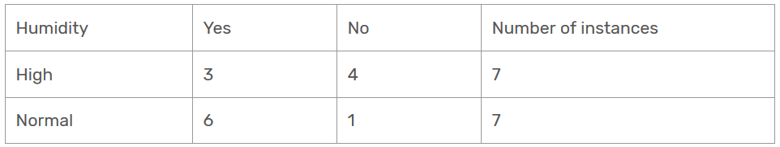
Humidity
Humidity is a binary class feature. It can be high or normal.
Gini(Humidity=High) = 1 – (3/7)² – (4/7)² = 1 – 0.183 – 0.326 = 0.489
Gini(Humidity=Normal) = 1 – (6/7)² – (1/7)² = 1 – 0.734 – 0.02 = 0.244
Weighted sum for humidity feature will be calculated next:
Gini(Humidity) = (7/14) x 0.489 + (7/14) x 0.244 = 0.367

Slide 8
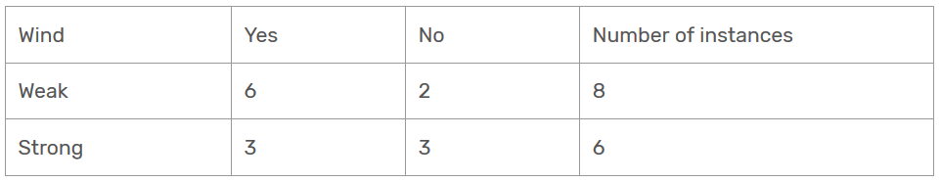
Wind
Wind is a binary class similar to humidity. It can be weak and strong.
Gini(Wind=Weak) = 1 – (6/8)² – (2/8)² = 1 – 0.5625 – 0.062 = 0.375
Gini(Wind=Strong) = 1 – (3/6)² – (3/6)² = 1 – 0.25 – 0.25 = 0.5
Gini(Wind) = (8/14) x 0.375 + (6/14) x 0.5 = 0.428

Slide 9
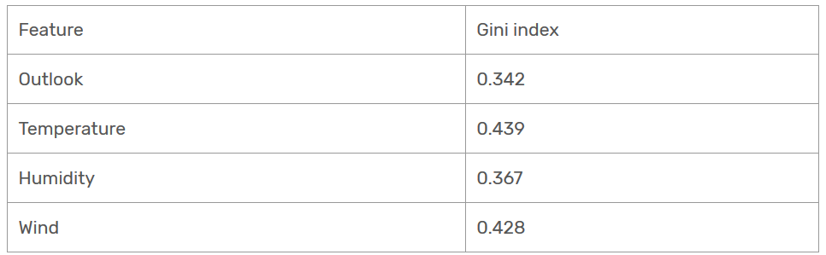
Time to decide
We’ve calculated gini index values for each feature.
The winner will be outlook feature because its cost is the lowest.

Slide 10
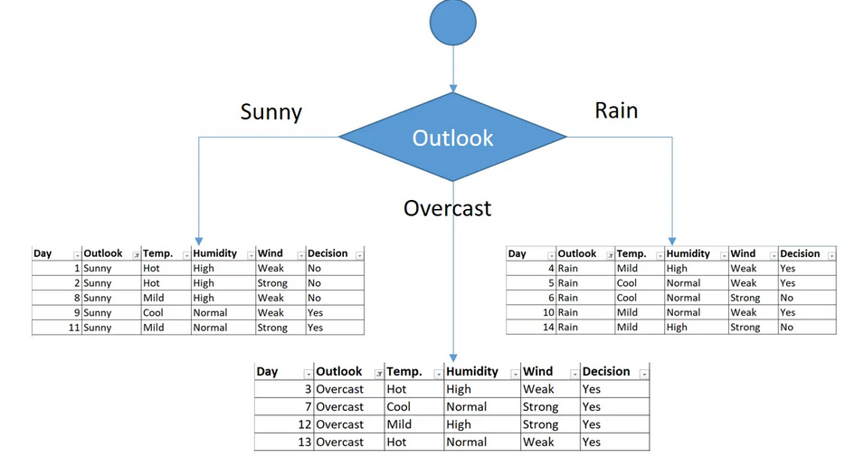
Root Node

Slide 11
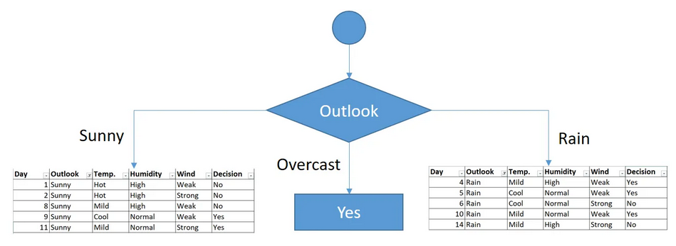
You might realize that sub dataset in the overcast leaf has only yes decisions. This means that overcast leaf is over.

Slide 12
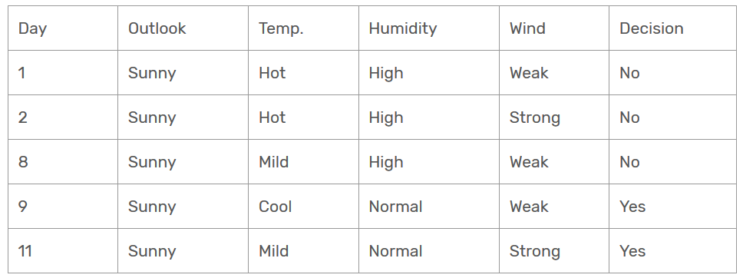
Second Level (Outlook=Sunny)
Focus on the sub dataset for sunny outlook.
We need to find the gini index scores for temperature, humidity and wind features respectively.

Slide 13
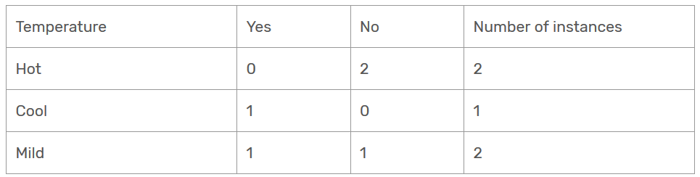
Gini of temperature for sunny outlook
Gini(Outlook=Sunny and Temp.=Hot) = 1 – (0/2)² – (2/2)² = 0
Gini(Outlook=Sunny and Temp.=Cool) = 1 – (1/1)² – (0/1)² = 0
Gini(Outlook=Sunny and Temp.=Mild) = 1 – (1/2)² – (1/2)² = 1 – 0.25 – 0.25 = 0.5
Gini(Outlook=Sunny and Temp.) = (2/5)x0 + (1/5)x0 + (2/5)x0.5 = 0.2

Slide 14
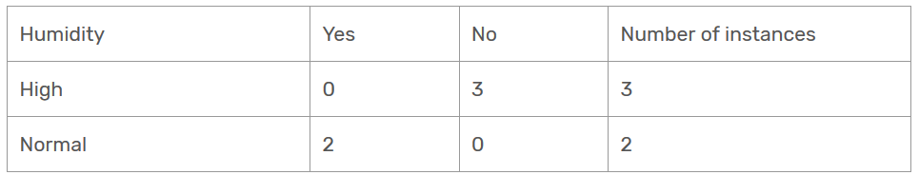
Gini of humidity for sunny outlook
Gini(Outlook=Sunny and Humidity=High) = 1 – (0/3)² – (3/3)² = 0
Gini(Outlook=Sunny and Humidity=Normal) = 1 – (2/2)² – (0/2)² = 0
Gini(Outlook=Sunny and Humidity) = (3/5)x0 + (2/5)x0 = 0

Slide 15
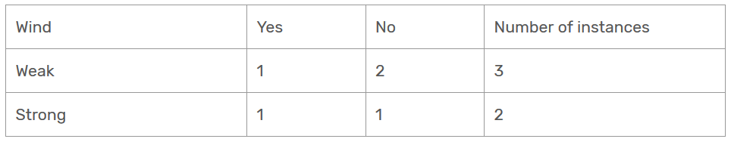
Gini of wind for sunny outlook
Gini(Outlook=Sunny and Wind=Weak) = 1 – (1/3)² – (2/3)² = 0.266
Gini(Outlook=Sunny and Wind=Strong) = 1- (1/2)² – (1/2)² = 0.2
Gini(Outlook=Sunny and Wind) = (3/5)x0.266 + (2/5)x0.2 = 0.466

Slide 16
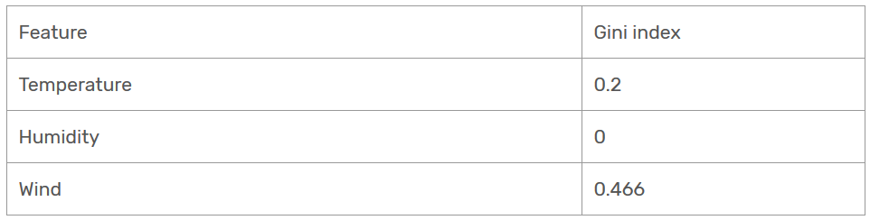
Decision for sunny outlook
We’ve calculated gini index scores for feature when outlook is sunny.
The winner is humidity because it has the lowest value.

Slide 17
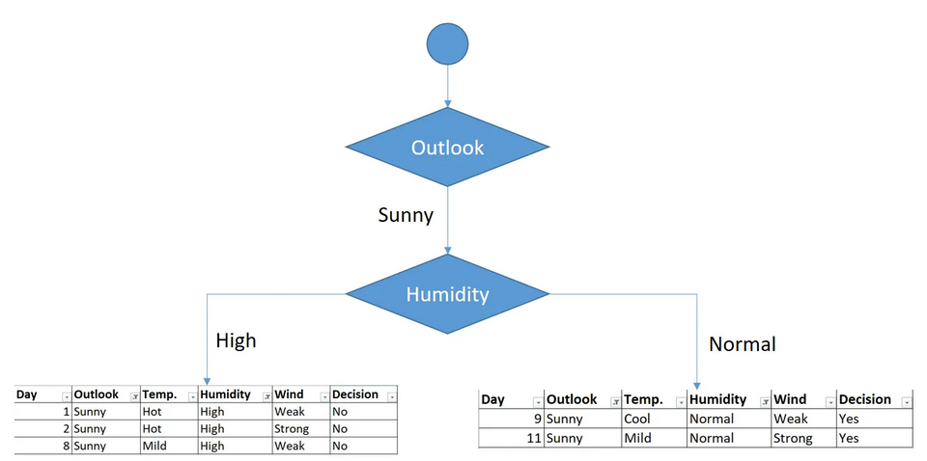
Second Level (Outlook = sunny)
As seen, decision is always no for high humidity and sunny outlook.
On the other hand, decision will always be yes for normal humidity and sunny outlook.

Slide 18
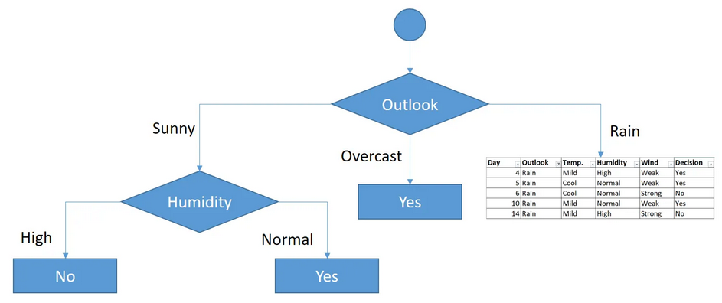
Second Level (Outlook = sunny)

Slide 19
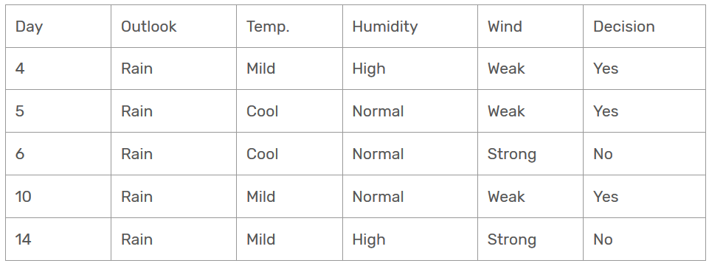
Second Level (Outlook = rain)
Now, we need to focus on rain outlook.
We’ll calculate gini index scores for temperature, humidity and wind features when outlook is rain.

Slide 20
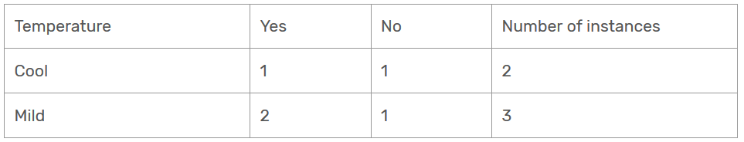
Gini of temprature for rain outlook
Gini(Outlook=Rain and Temp.=Cool) = 1 – (1/2)² – (1/2)² = 0.5
Gini(Outlook=Rain and Temp.=Mild) = 1 – (2/3)² – (1/3)² = 0.444
Gini(Outlook=Rain and Temp.) = (2/5)x0.5 + (3/5)x0.444 = 0.466

Slide 21
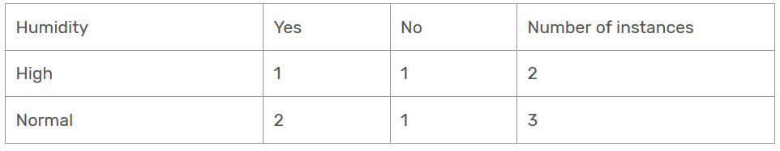
Gini of humidity for rain outlook
Gini(Outlook=Rain and Humidity=High) = 1 – (1/2)² – (1/2)² = 0.5
Gini(Outlook=Rain and Humidity=Normal) = 1 – (2/3)² – (1/3)² = 0.444
Gini(Outlook=Rain and Humidity) = (2/5)x0.5 + (3/5)x0.444 = 0.466

Slide 22
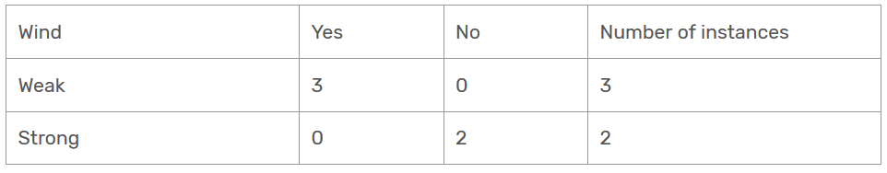
Gini of wind for rain outlook
Gini(Outlook=Rain and Wind=Weak) = 1 – (3/3)² – (0/3)² = 0
Gini(Outlook=Rain and Wind=Strong) = 1 – (0/2)² – (2/2)² = 0
Gini(Outlook=Rain and Wind) = (3/5)x0 + (2/5)x0 = 0

Slide 23
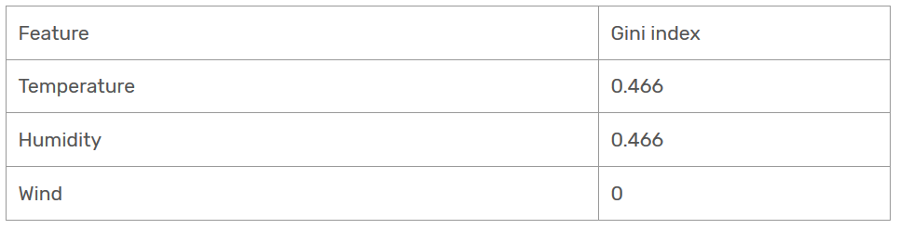
Decision for rain outlook
The winner is wind feature for rain outlook because it has the minimum gini index score in features.

Slide 24
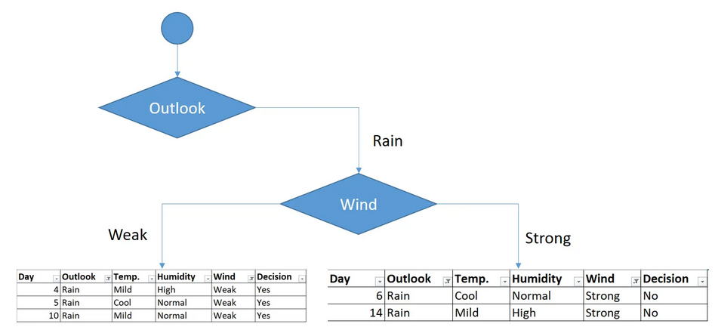
Second Level (Outlook = rain)
Put the wind feature for rain outlook branch and monitor the new sub data sets.

Slide 25
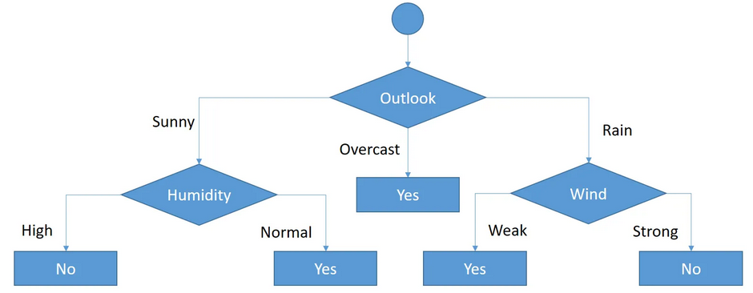
Second Level (Outlook = rain)
As seen, decision is always yes when wind is weak.
On the other hand, decision is always no if wind is strong.

Slide 26
Thank You !!!

